Slide 1
Chapter 8 Inferences About More Than Two Population Central Values
STAT 441/541 Statistical Methods II

Slide 2
Motivating Example: Silt Content of Soils
Eight contiguous sites
11 random points within each site
All samples taken from same depth
Soil property of interest is silt content
Objective: Determine if there is a difference in silt content among the soils from different sites
Activity: Review the handout Silt Content of Soils

Slide 3
Sections Covered
8.1 Introduction
8.2 A Statistical Test About More Than Two Population Means: An Analysis of Variance (ANOVA)
8.3 The Model for Observations in a Completely Randomized Design
8.4 Checking the ANOVA Conditions

Slide 4
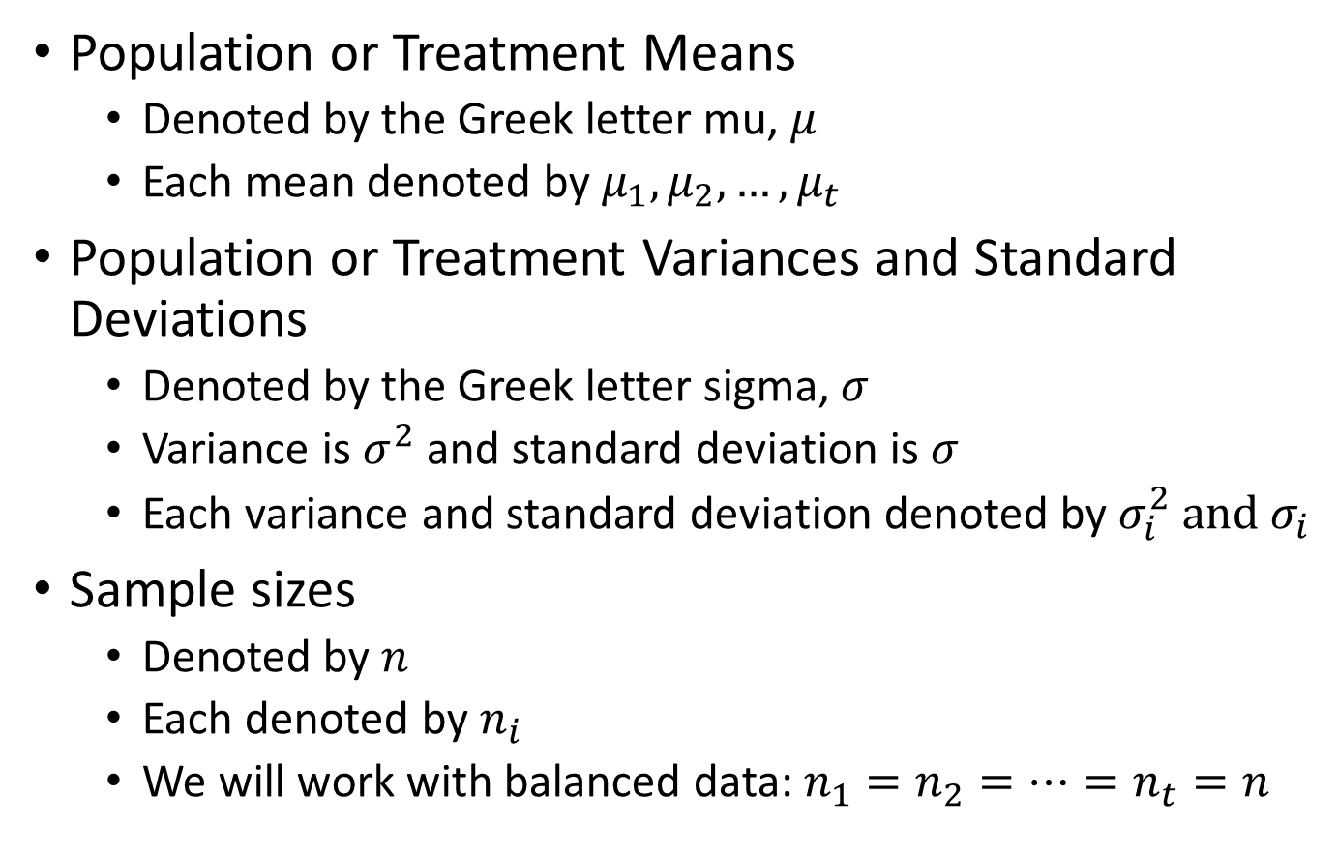
Notation Refresher
Population or Treatment Means
Denoted by the Greek letter mu, $μ$
Each mean denoted by $μ_{1},μ_{2}, …,μ_{t}$
Population or Treatment Variances and Standard Deviations
Denoted by the Greek letter sigma, $σ$
Variance is $σ^{2}$ and standard deviation is $σ$
Each variance and standard deviation denoted by $σ_{i}^{2} and σ_{i}$
Sample sizes
Denoted by $n$
Each denoted by $n_{i}$
We will work with balanced data: $n_{1}=n_{2}=…=n_{t}=n$

Slide 5
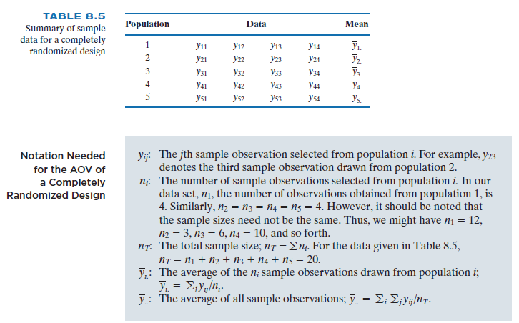
Notation for t treatments
Note: The text uses “population” but I am using “treatment”

Slide 6
Statistical Dataset
Columns are variables
Variables denoting treatments are called factors
Treatments can be identified by numbers, characters, or a combination of both
Rows are observations
Each observation consists of a value for the response variable and a value that identifies the treatment
We are using Excel (.xlsx) files for our statistical datasets
Activity: Complete the handout Fun with a Statistical Dataset for One-Way ANOVA

Slide 7
Section 8.1 Introduction
Many practical and scientific settings want to compare the means of three or more populations, or treatments
The testing procedure called analysis of variance will detect differences among sample means from each population, or treatment
Two sources of variation:
Within-sample variation, and
Between-sample variation
All differences between sample means are judged statistically significant (or not) by comparing them to the variation within samples

Slide 8
Section 8.2 A Statistical Test for more than Two Population Means: An Analysis of Variance
The analysis of variance procedures are developed under the following conditions:
Each of the populations, or treatments, has a normal distribution,
The variances of the populations, or treatments, are equal (there is a common variance), and
The measurements are independent random samples from their respective populations

Slide 9
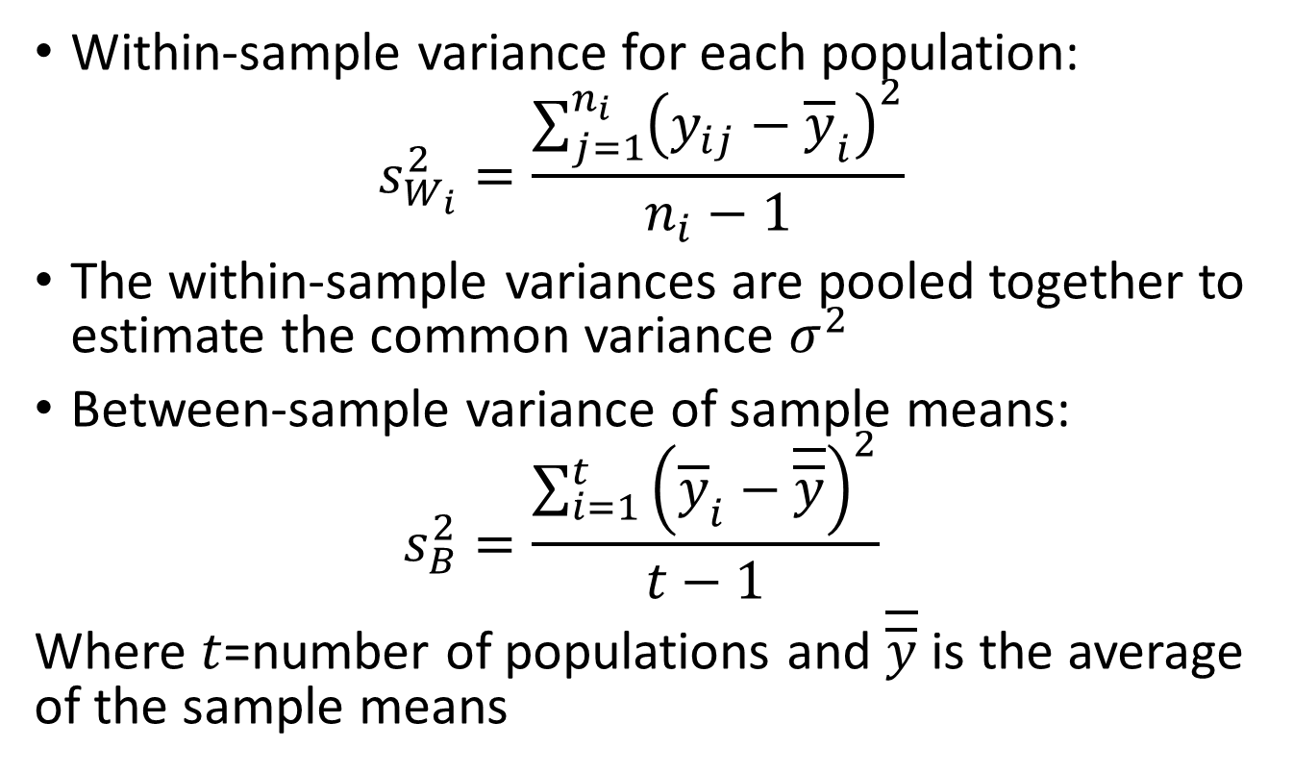
Estimating Within-sample and Between-sample Variation
Within-sample variance for each population:
$$s_{W_{i}}^{2}=\frac{\sum_{j=1}^{n_{i}}{{\left(y_{ij}−{\overline{y}}_{i}\right)}^{2}}}{n_{i}−1}$$
The within-sample variances are pooled together to estimate the common variance $σ^{2}$
Between-sample variance of sample means:
$$s_{B}^{2}=\frac{\sum_{i=1}^{t}{{\left({\overline{y}}_{i}−\overline{\overline{y}}\right)}^{2}}}{t−1}$$
Where $t$=number of populations and $\overline{\overline{y}}$ is the average of the sample means

Slide 10
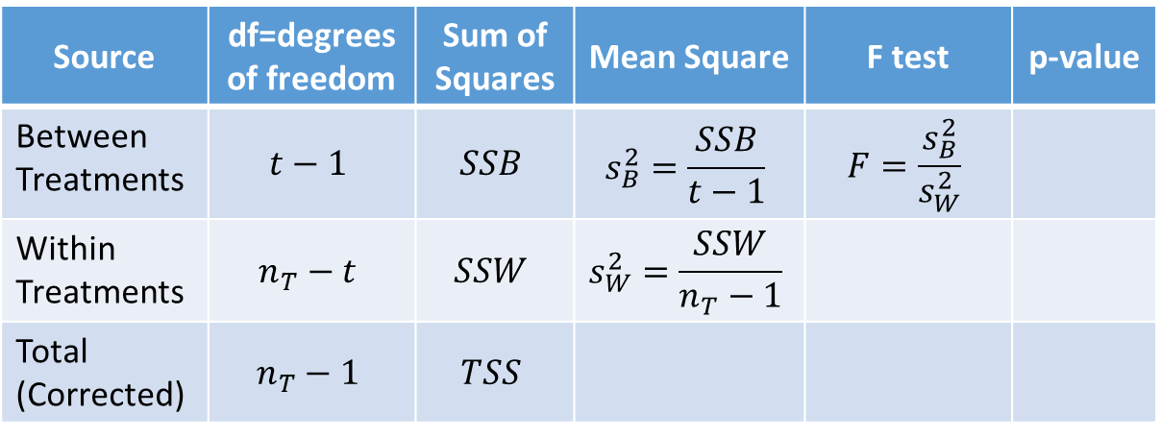
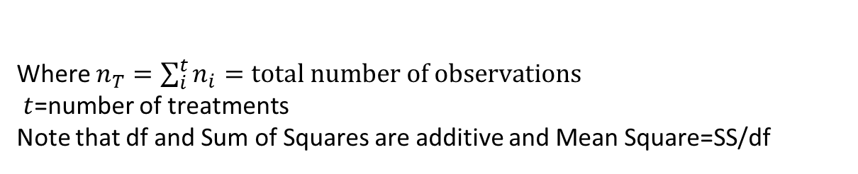
Analysis of Variance Table
Used to partition of Total (Corrected) Sum of Squares (TSS) into two components:
Between Treatments (SSB), and
Within Treatments (SSW)
Source | df=degrees of freedom | Sum of Squares | Mean Square | F test | p-value
Between Treatments | $$t−1$$ | $$SSB$$ | $$s_{B}^{2}=\frac{SSB}{t−1}$$ | $$F=\frac{s_{B}^{2}}{s_{W}^{2}}$$
Within Treatments | $$n_{T}−t$$ | $$SSW$$ | $$s_{W}^{2}=\frac{SSW}{n_{T}−1}$$
Total (Corrected) | $$n_{T}−1$$ | $$TSS$$
Where $n_{T}=\sum_{i}^{t}{n_{i}=total number of observations}$
$t$=number of treatments
Note that df and Sum of Squares are additive and Mean Square=SS/df

Slide 11
Section 8.3 Models for Observations in a Completely Randomized Design (CRD)
Some important definitions
Treatments: conditions selected by the researcher, such as different types of pesticides
Experimental Unit: the physical entity to which the treatment is randomly assigned, such as test plots
Completely Randomized Design: an experimental setting in which treatments are randomly assigned to a large group of homogeneous experimental units
Activity: Complete the handout “Fun with Experimental Unit”

Slide 12
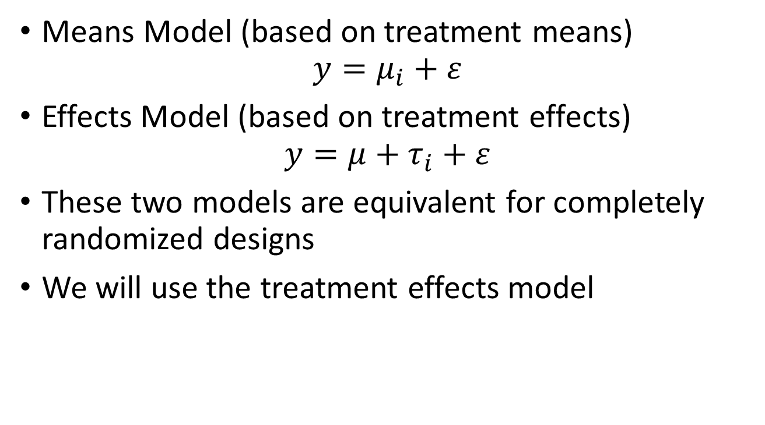
Two Models for a CRD
Means Model (based on treatment means)
$$y=μ_{i}+ε$$
Effects Model (based on treatment effects)
$$y=μ+τ_{i}+ε$$
These two models are equivalent for completely randomized designs
We will use the treatment effects model

Slide 13
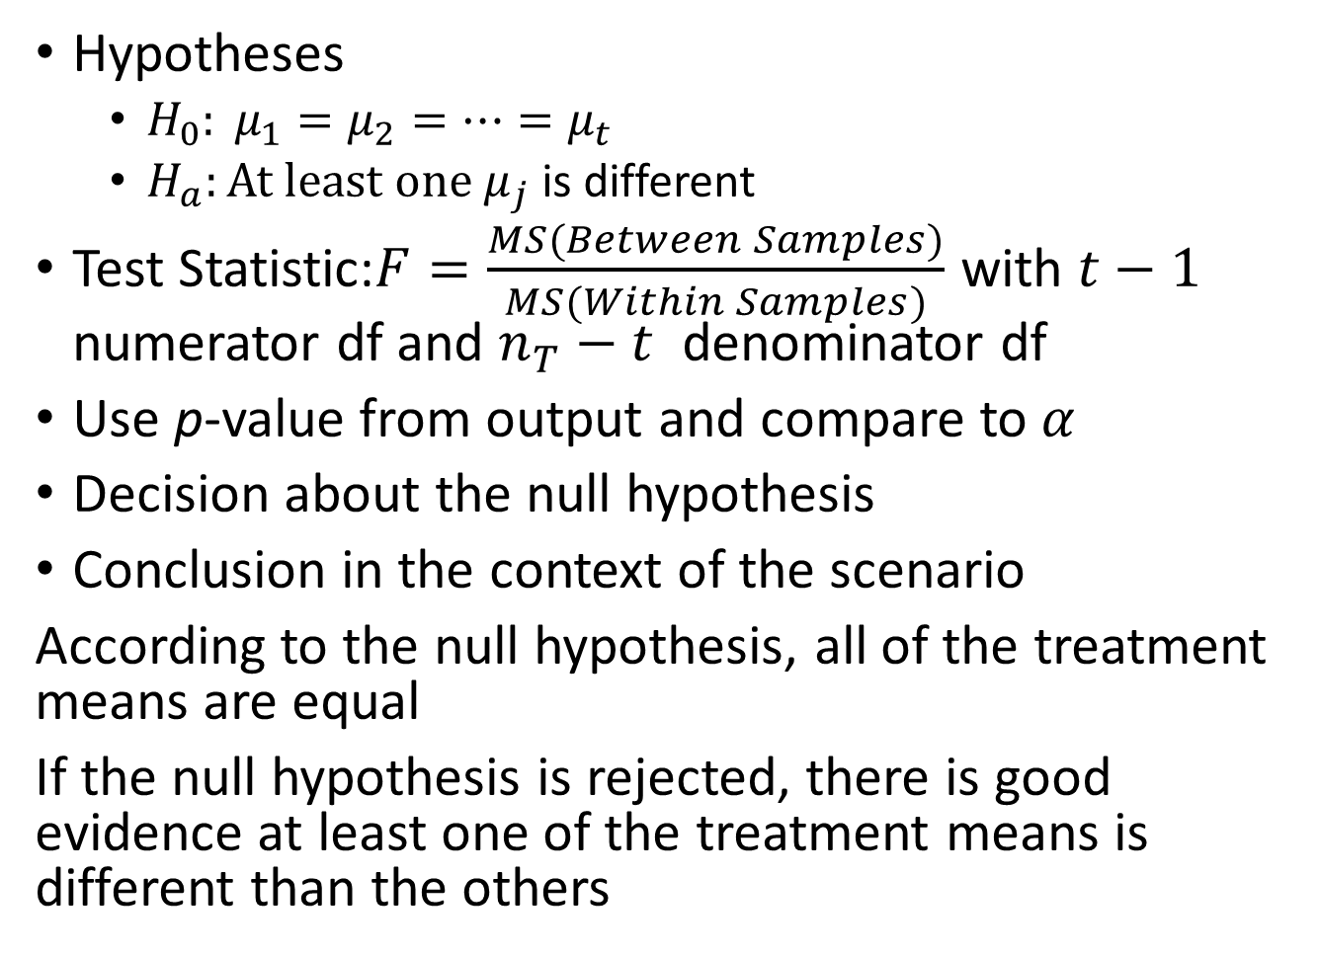
Hypothesis Test for Means Model
Hypotheses
$H_{0}: μ_{1}=μ_{2}=⋯=μ_{t}$
$H_{a}:At least one μ_{j}$ is different
Test Statistic:$F=\frac{MS(Between Samples)}{MS(Within Samples)}$ with $t−1$ numerator df and $n_{T}−t$ denominator df
Use p-value from output and compare to $α$
Decision about the null hypothesis
Conclusion in the context of the scenario
According to the null hypothesis, all of the treatment means are equal
If the null hypothesis is rejected, there is good evidence at least one of the treatment means is different than the others

Slide 14
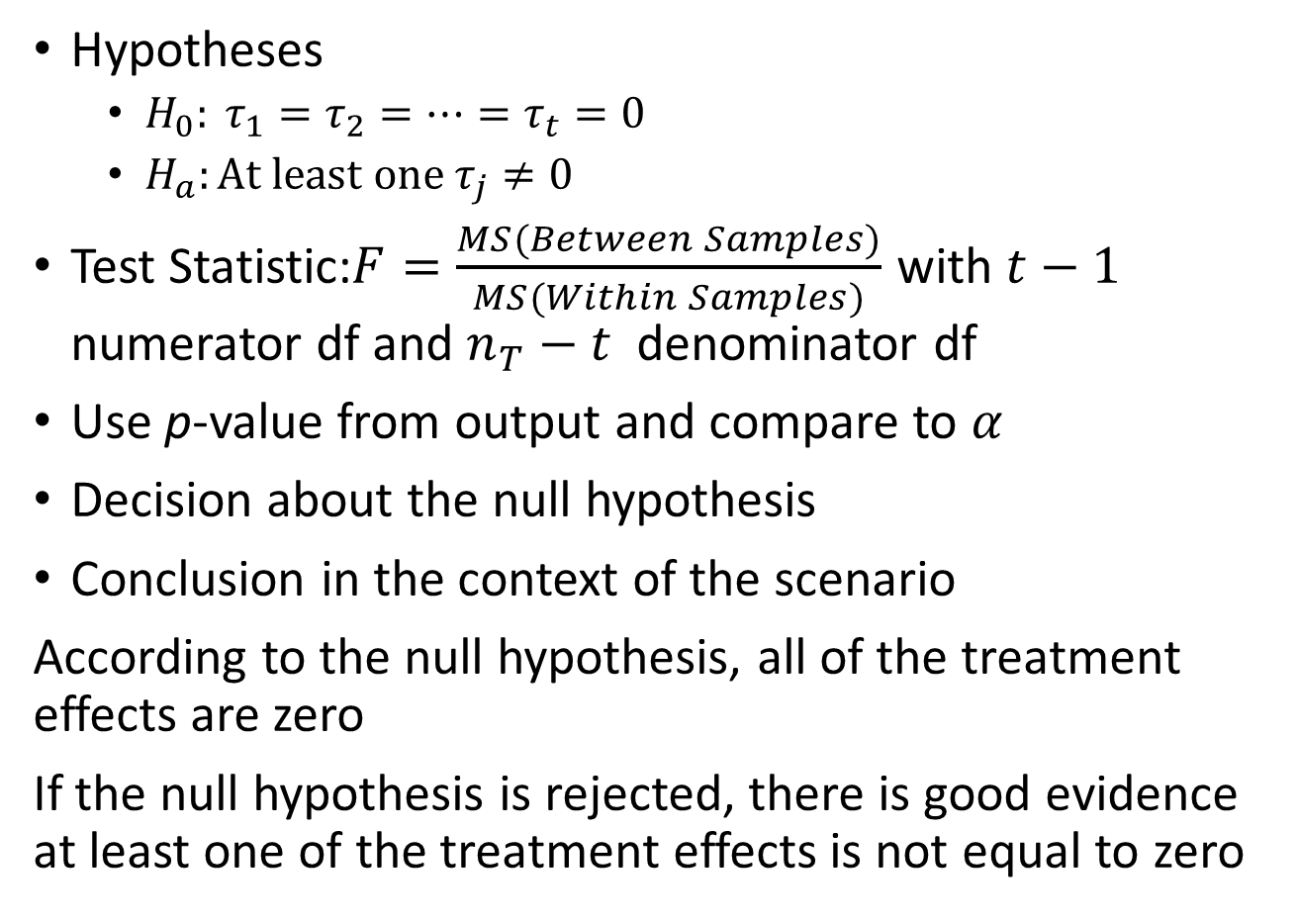
Hypothesis Test for Effects Model
Hypotheses
$H_{0}: τ_{1}=τ_{2}=⋯=τ_{t}=0$
$H_{a}:At least one τ_{j}≠0$
Test Statistic:$F=\frac{MS(Between Samples)}{MS(Within Samples)}$ with $t−1$ numerator df and $n_{T}−t$ denominator df
Use p-value from output and compare to $α$
Decision about the null hypothesis
Conclusion in the context of the scenario
According to the null hypothesis, all of the treatment effects are zero
If the null hypothesis is rejected, there is good evidence at least one of the treatment effects is not equal to zero

Slide 15
Section 8.4 Checking on the AOV Conditions (Assumptions)
NOTE: Out text uses AOV but I will continue to use ANOVA
We will check the conditions of ANOVA by using the following assumptions:
Errors are normally distributed
Normal Q-Q plot and Shapiro-Wilk Test
There are no outliers
Look for unusual points in plots
There is a common variance
Levene’s Test for Homogeneity of Variance
Activity: Complete the handout Checking ANOVA Assumptions

